Slide 1
Multivariate Analysis Final Project
Daniel Alonso, Limingrui Wan & Danyu Zhang

Slide 2
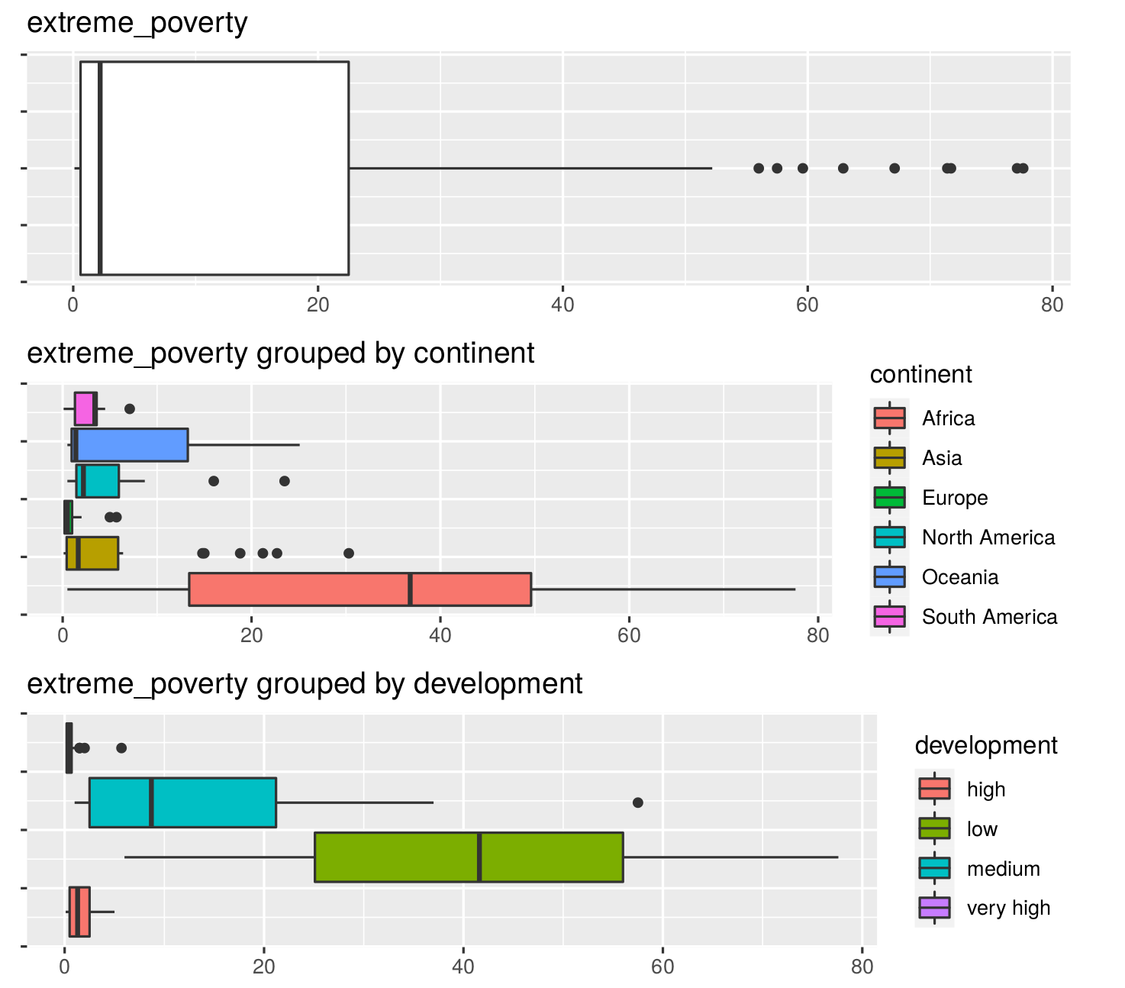
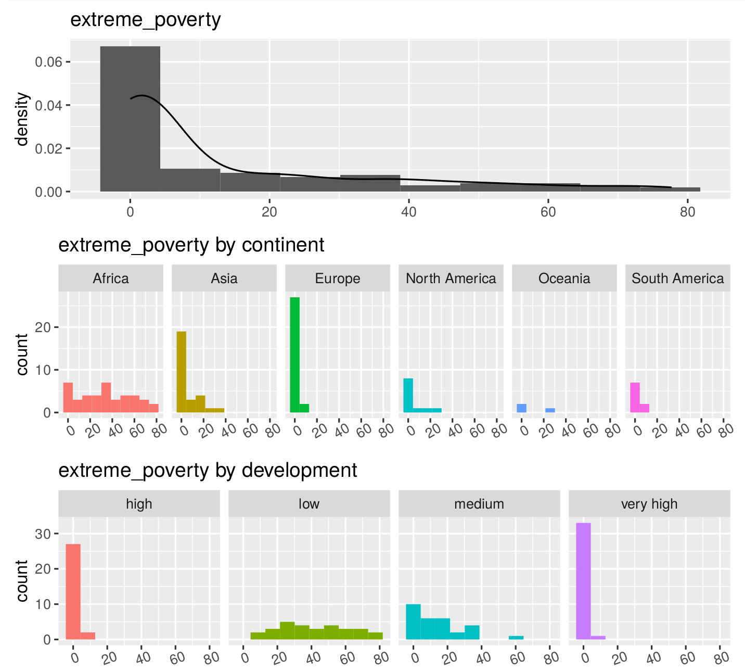
1. Visualization of Our Data Set
The amount of hospital beds per thousand inhabitants, the life expectancy, GDP per capita, median age, percentage of population above 65 years of age all tend to be lower the lower the HDI.
Life expectancy itself is a component of HDI, but it is clear that all these measures are in one way or another measures of quality of life and development, therefore the higher they are, the higher HDI will also be.
There is a clear relationship between extreme poverty and very low HDI.
The relationship between extreme poverty and HDI is the opposite, so the lower the HDI, the higher the percentage of the population living in extreme poverty conditions.

Slide 3
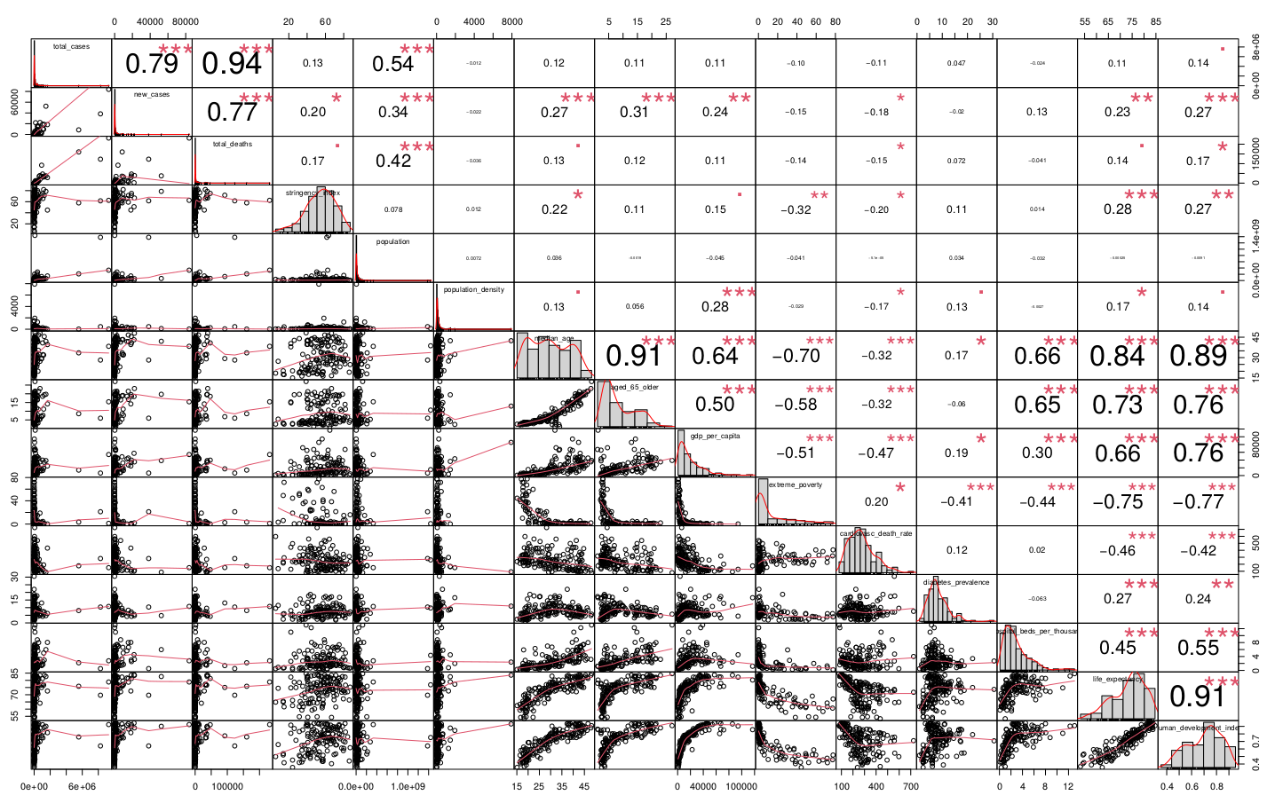
1. Visualization of Our Data Set
Correlation Plot between all the variables
We found that interestingly, many highly developed countries seem to be doing worse than less developed countries when it comes to handling the pandemic.
However, this could be in a way countered by stating that it could all be due to less widespread testing along with how common movement of people is in more developed countries vs less developed countries.

Slide 4
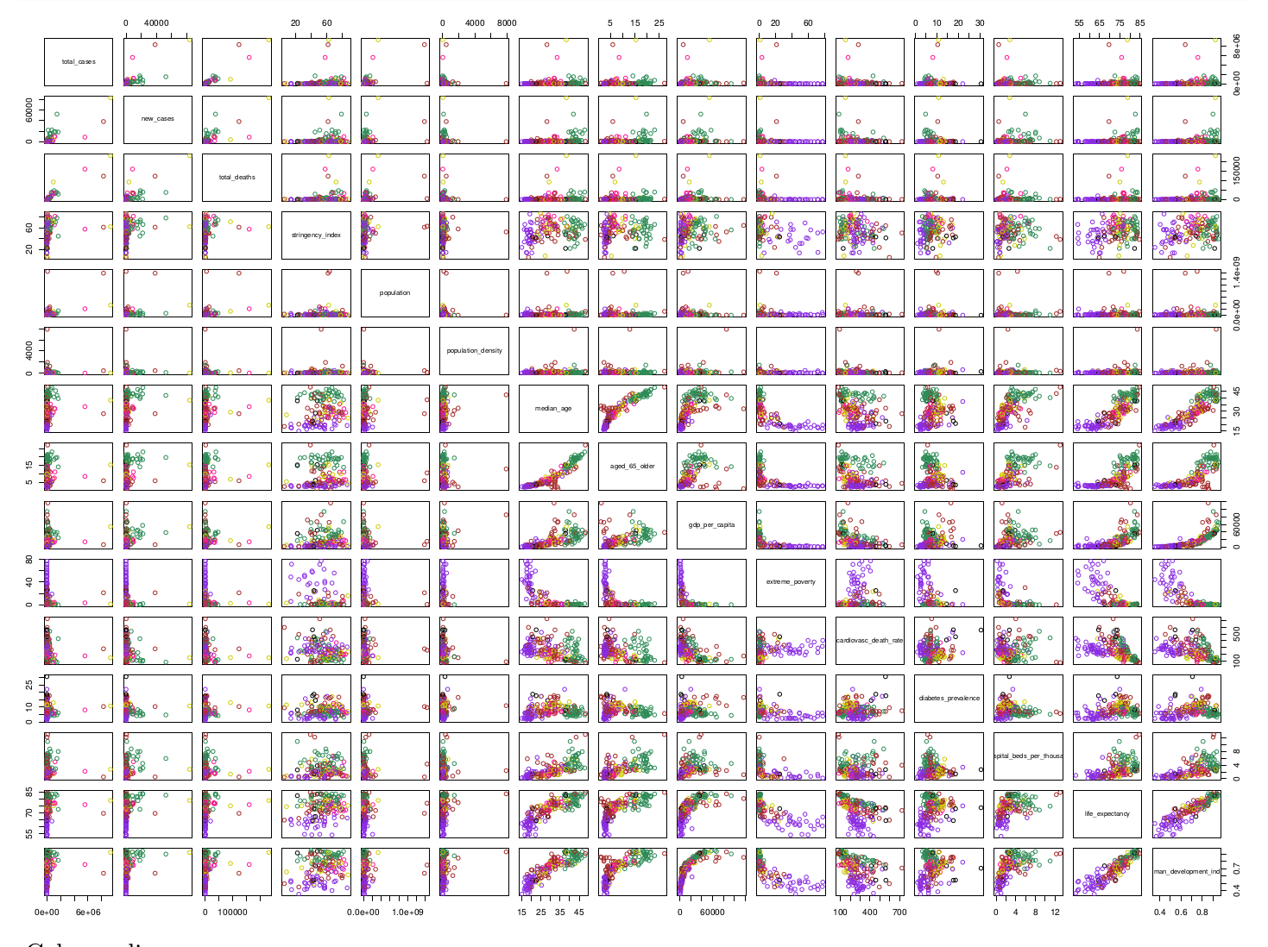
1. Visualization of Our Data Set
Correlation Plot between all the variables grouped by continents
Usually, whenever there’s a tendency for highly developed nations to have a specifically higher metric, like GDP per capita, there’s a tendency for Europe and a few other nations in other continents to be at the top, while African countries tend to be at the bottom.
Here we clearly see Europe (green) topping most charts (with the exception of extreme poverty) and Africa at the bottom of most charts (with again the exception of extreme poverty).
We could not directly identify any clear correlation between how poor a country is and how much the pandemic has affected it in terms of total cases or death numbers. However, the minimal value we got for its correlation coefficient was negative, therefore maybe hinting that less developed nations could, perhaps, have a slight tendency to be less affected by the pandemic in terms of case/death numbers.
We did however find that the restrictions in extremely poor nations tended to be less strict.

Slide 5
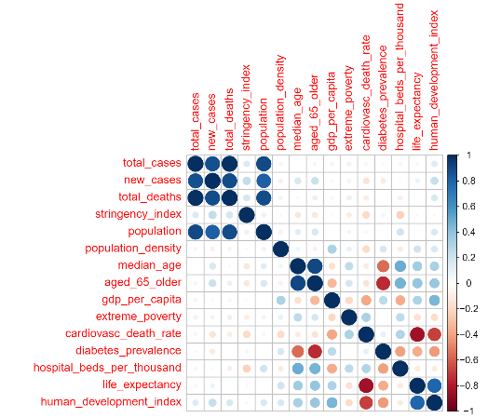
2. Mean Vector, Covariance Matrix
Correlation plot for high level of HDI:
For those countries with very high development index, diabetes prevalence has a negative linear relationship with proportion of population over 65 years old.

Slide 6
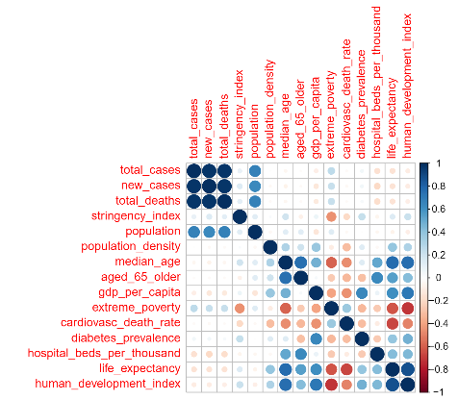
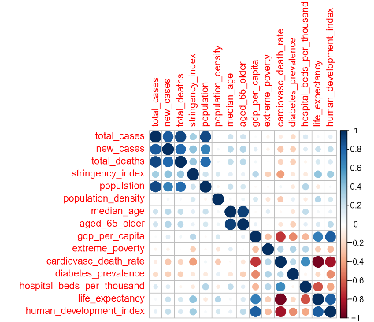
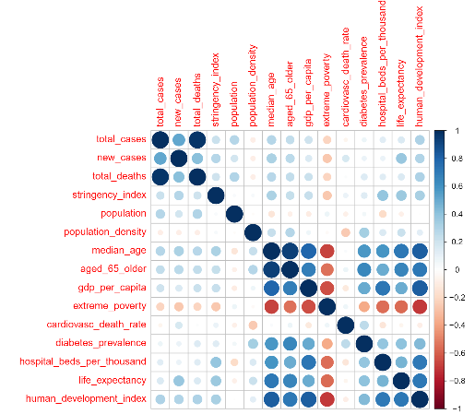
2. Mean Vector, Covariance Matrix
For Asia, there exists a linear relationship between total cases and population, this relationship could be significantly skewed by India.
For Africa, median age is negatively correlated with GDP per capita, life expectancy and human development index.
In Europe, cardiovascular death rate has negative linear relationship with life expectancy and human development index.

Slide 7
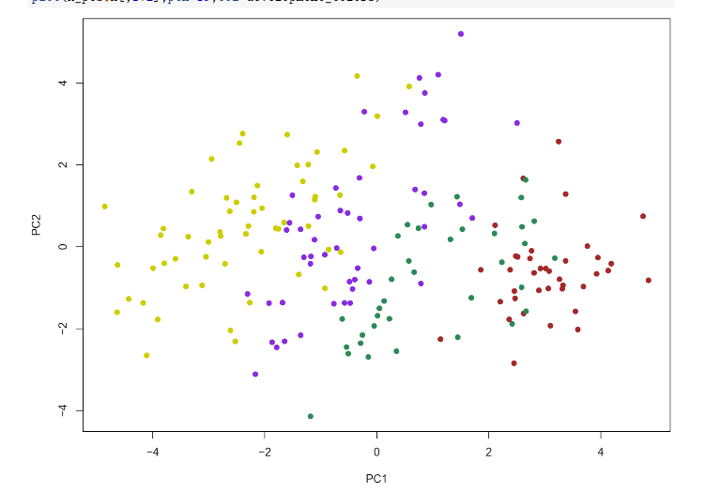
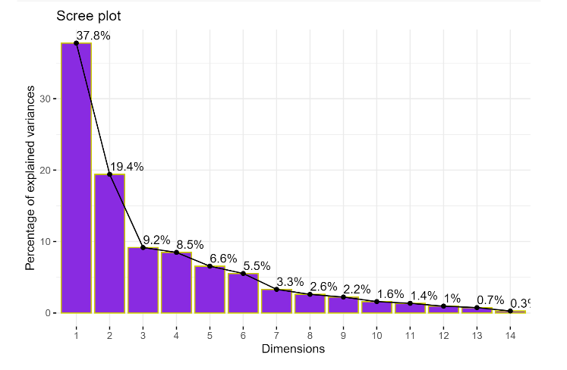
3. Principal Component Analysis: By HDI
PC differentiate almost perfectly the different levels of HDI.
Variance explained by each principal component by using scree plot, we have decided to take the first 5 PCs, we will be using the 33% of the total variables and will be keeping the 82% of the total information.

Slide 8
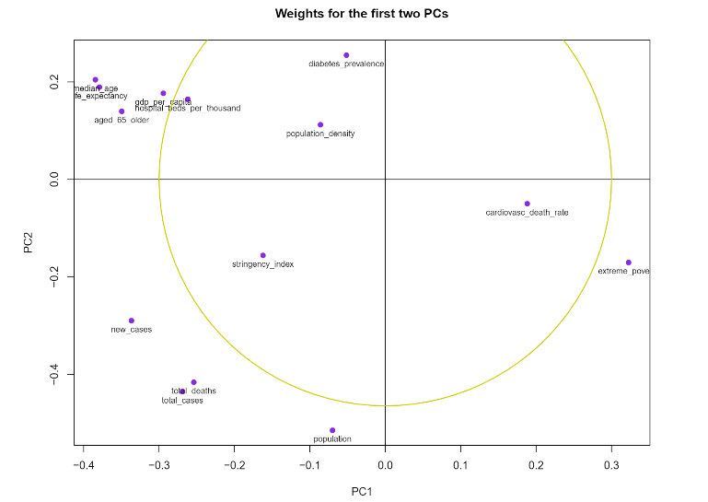
3. Principal Component Analysis: By HDI
Weights for the first PCs, the largest values in magnitude of first principal component are associated with developing countriess because of the high values of the variable extreme poverty and high rate of cardiovascular death rate.
The largest values in magnitude of second PC are associated with developed countries because of the high values of the variable GDP per capita, life expectancy and hospital beds per thousands.
On the other hand, there is something interesting here, it may tell us that the people from highly developed countries may be more prone to develop diabetes.

Slide 9
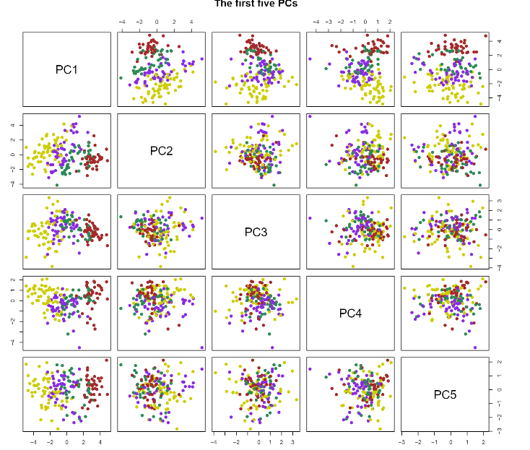
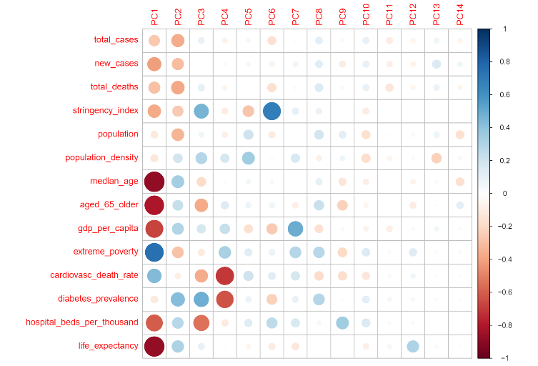
3. Principal Component Analysis: By HDI
First five PC scores here, and it shows that the first principal component is the key to show the 4 groups of development.
Correlation between the original variables and the PCs.
The variables that are important for the 1st PC are median age, life expectancy, percentage of aged 65 and older with a negative correlation, and extreme poverty, cardiovascular death rate with a positive correlation. The higher the first pincipal component is, the lower the HDI a country will most likely be, and the other way around.
On the contrary, the second principal component is positively correlated to GDP per capita, and negatively correlated to total deaths and total cases of COVID-19. Which probably means that, the higher value of PC2, the more developed a country is (higher HDI).

Slide 10
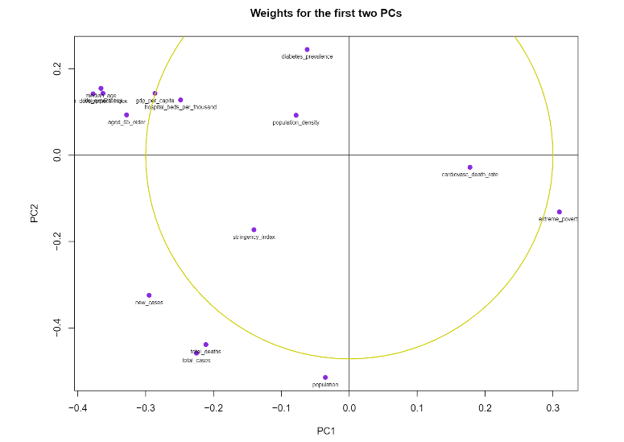
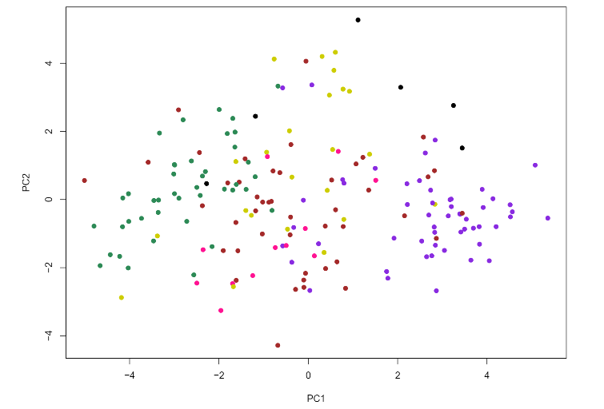
3. Principal Component Analysis: By Continent
We can observe here the PCs don’t differentiate perfectly all 6 continents, but it classifies very well between Europe (seagreen) and Africa (blueviolet), just as what we had hypothesised on the first part.
And we cannot comfortably conclude anything about Oceania as we only have 6 observations for it.
The conclusions that we can get from this plot are very similar to the other one.
Largest values in magnitude of first PC are associated with less developed countries because of the high values of the variable extreme poverty and high rate of cardiovascular death rate.
Largest values in magnitude of second PC are associated with more developed countries because of the high values of HDI, GDP per capita, life expectancy and hospital beds per thousand.

Slide 11
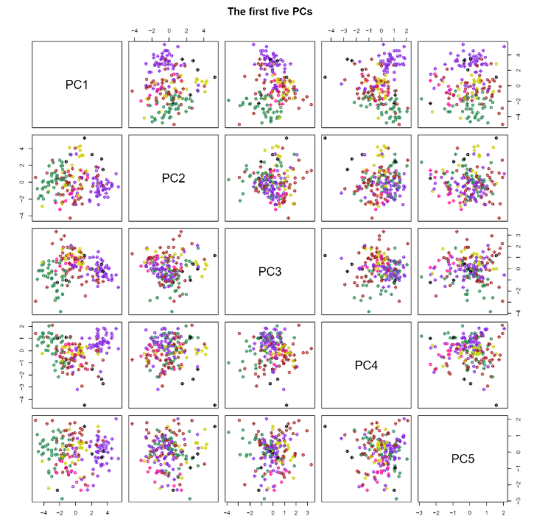
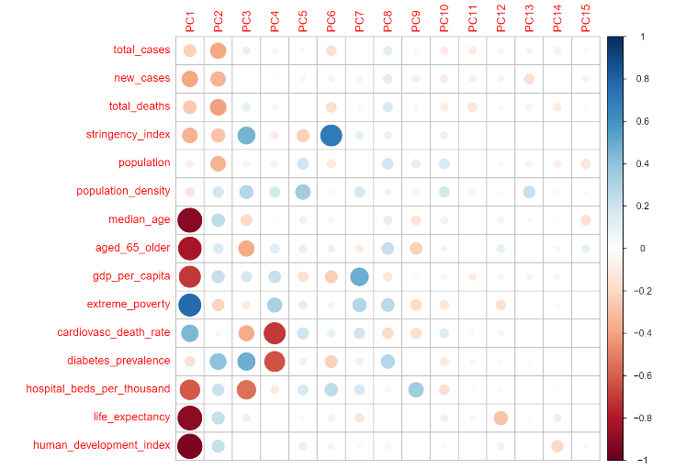
3. Principal Component Analysis: By Continent
plot of correlation between the original variables and the PCs.
The variables that are important for the first PCs are the same with the addition of HDI with a negative correlation. The higher the 1st PC is, the higher the probability that the country belongs to Africa and that it is not in Europe, but we cannot say anything about the other continents as there are not enough differences between them for us to classify.
On the other hand, the second PC is also very similar to our first PCA, which probably means that, the higher the value of PC2, the more likely it becomes that it is located in Europe.
First five PC scores, and it shows that the first principal component is the key to show the the difference between Europe and Africa.

Slide 12
Thank you for your attention!

